Slide 1
Kantineapp – Team LOL

Slide 2
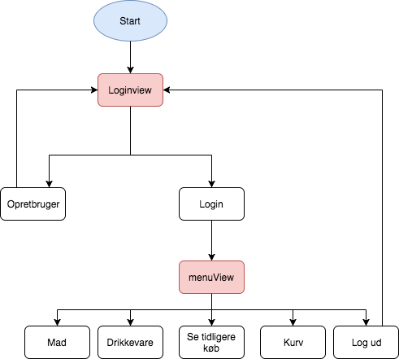
Kantineapp – Team LOL

Slide 3
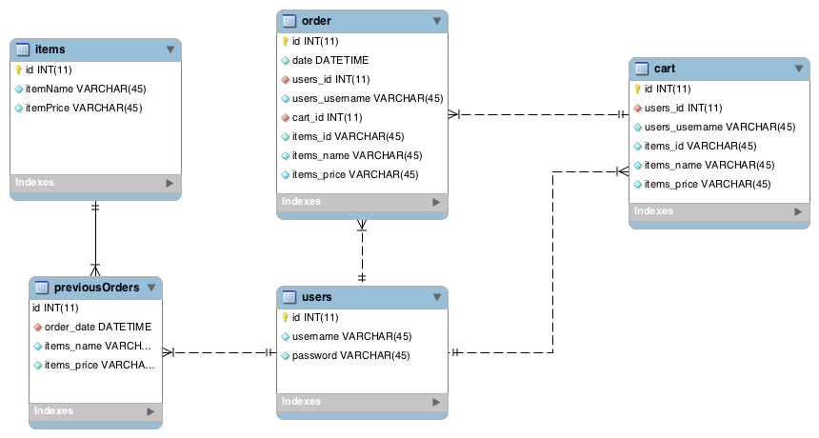
Kantineapp – Team LOL

Slide 4
